Slide 1
Project Deliverable 1 - Expert System
Investment Portfolio
Simon Guindon 40058301
Feb-20-2026

Slide 2
Problem Domain
For this expert system assignment, I opted to work on a investment portfolio service that will recommend users a blend of investment for their given risk tolerance, age, time horizon and available funds.
My motivation for selecting this topic is my strong interest in financial market and investments in equities. To make sure that the information given by my expert system is reliable and accurate, I used established reputable sources for financial literature. My main target demographic is an early stage investor who feels intimidated by the financial world but wants to maximize their portfolio’s returns in accordance to their goals (Ex. max growth vs stability).
My problem domain has authoritative information available from books written by economists and financial analyst.

Slide 3
Knowledge Domain
My knowledge domain is based on the following three books and one article published by relevant professionals in the domain:
[1] Fabozzi, F. J. and Markowitz, H. M. (Eds.). The Theory and Practice of Investment Management: Asset Allocation, Valuation, Portfolio Construction, and Strategies, 2nd ed. John Wiley & Sons, 2011.
[2] Stanyer, P. The Economist Guide to Investment Strategy: How to Understand Markets, Risk, Rewards and Behaviour, 3rd ed. Public Affairs, 2014.
[3] Thau, A. The Bond Book: Everything Investors Need to Know About Treasuries, Municipals, GNMAs, Corporates, Zeros, Bond Funds, Money Market Funds, and More, 3rd ed. McGraw-Hill, 2010.
[4] Markowitz, H. M. Portfolio Selection. The Journal of Finance, 7(1):77–91, 1952.
Since most beginner investors will make the same allocation errors due to a lack of knowledge, the proposed expert system will be useful to many new investors.

Slide 4
Project Goal
The goal is to develop an expert system that will automatically suggest investment advices for portfolio allocation in accordance with the user’s four attributes (risk tolerance, age, time horizon and net worth) and output a customized assets allocation over 10 investment vehicles (individual stocks, diversified ETFs, corporate or government bonds, guaranteed investment certificate, cash and gold, REIT, High yield bonds, emerging market ETFs) allocation.

Slide 5
SMART analysis of Project Goal
Specific: The system will provide a rigid investment allocation based on the user's attribute (risk profile, age, time horizon, net worth)
Measurable: Every user profile will receive one recommendation for their portfolio allocation with a description of why the recommendation fits them.
Achievable: Once the user receives their recommendation, implementing it is the easy part through an online investment platform.
Relevant: The expert system provides new investors the portfolio information that they lacked to make an educated choice.
Time-bound : Investors can immediately act after obtaining their suggested allocation.

Slide 6
Target User
User (U): The targeted user is a first-time investor who has savings but is uninformed about investment vehicles, and doesn't have sufficient financial literacy to make an optimized portfolio strategy.
U's description:
- Age between 18-65 (young workers, mid career adults or older adults approaching retirement).
- Net worth ranging from a few hundreds to several tens of thousand of dollars.
- The user wants their invested funds available in a short, medium or long time horizon.
- Risk tolerance ranging from Low-Medium-High.

Slide 7
Factbase (F) - Total 10 facts
Individual Stocks Description: Shares in individual companies. Risk: High | Average Return: 10%
Emerging Markets ETF Description: Stocks from developing nations; high volatility with high growth potential. Risk: High | Average Return: 9%
High-Yield Bonds Description: Lower quality "junk" bonds; carries high credit risk for higher yield. Risk: High | Average Return: 7%
Diversified ETF Description: Passive index funds providing broad market diversification. Risk: Medium | Average Return: 7%
Real Estate (REIT) Description: Real Estate Investment Trusts; income-generating property assets.Risk: Medium | Average Return: 6%
Corporate Bonds Description: Corporate debt; higher yield to compensate for default risk. Risk: Medium | Average Return: 5%
Gold Description: A physical commodity used as an inflation hedge and diversifier. Risk: Medium | Average Return: 5%
GIC (Guaranteed Investment Certificate) Description: Principal-guaranteed bank investment for safe, locked-in returns. Risk: Low | Average Return: 4.5%
Government Bonds Description: Government debt; virtually no default risk but lower returns than corporate debt. Risk: Low | Average Return: 3%
Cash (HISA) Description: Funds held in High-Interest Savings Accounts; maximum liquidity with lowest return. Risk: Low | Average Return: 2%

Slide 8
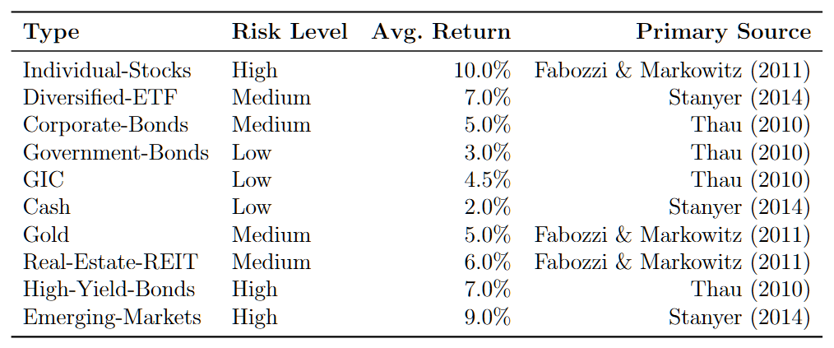
Factbase (F)
Facts are summarized in table below

Slide 9
Rulebase (R) - Rules 1 & 2
get-user-profile A rule that prompts the user for their name, age, risk tolerance, investable capital, and time horizon.
infer-horizon-from-age If a user is unsure about the time horizon, this rule estimates it by subtracting their current age from 65 (to act like a retirement goal).

Slide 10
Rulebase (R) - Rules 3 to 7
capital-preservation-strategy Selects a 100% fixed-income/cash portfolio for low-risk profiles (under 5 years) or any investor with an horizon under 3 years. Allocation: 50% Gov Bonds / 30% GIC / 20% Cash | ~2.9% return. [Stanyer 2014; Thau 2010]
safe-mid-growth-strategy Recommends a cautious equity allocation for low-risk investors with horizons over 5 years, or medium-risk investors with 3–5 year horizons. Allocation: 20% ETF / 35% Gov Bonds / 15% Corp Bonds / 20% GIC / 10% Cash | ~3.8% return. [Stanyer 2014; Fabozzi & Markowitz 2011]
mid-growth-strategy Recommends a balanced 50/50 split for medium-risk profiles (5–10 years) or high-risk investors with short timelines (3–5 years). Allocation: 50% ETF / 30% Gov Bonds / 10% Corp Bonds / 10% Cash | ~5.0% return. [Stanyer 2014; Fabozzi & Markowitz 2011; Thau 2010]
aggressive-mid-growth-strategy Recommends strong equity and gold allocation for medium- risk investors with horizons over 10 years, or high-risk investors with 5–10 year timelines. Allocation 60% Stocks / 20% ETF / 10% Corp Bonds / 10% Gold | ~7.5% return. [Stanyer 2014; Fabozzi & Markowitz 2011]
aggressive-growth-strategy Recommends maximum equity exposure for high-risk investors with horizons over 10 years. Allocation 75% Stocks / 15% Emerging-Markets / 5% Gov Bonds / 5% Gold | ~8.5% return. [Stanyer 2014; Fabozzi & Markowitz 2011]

Slide 11
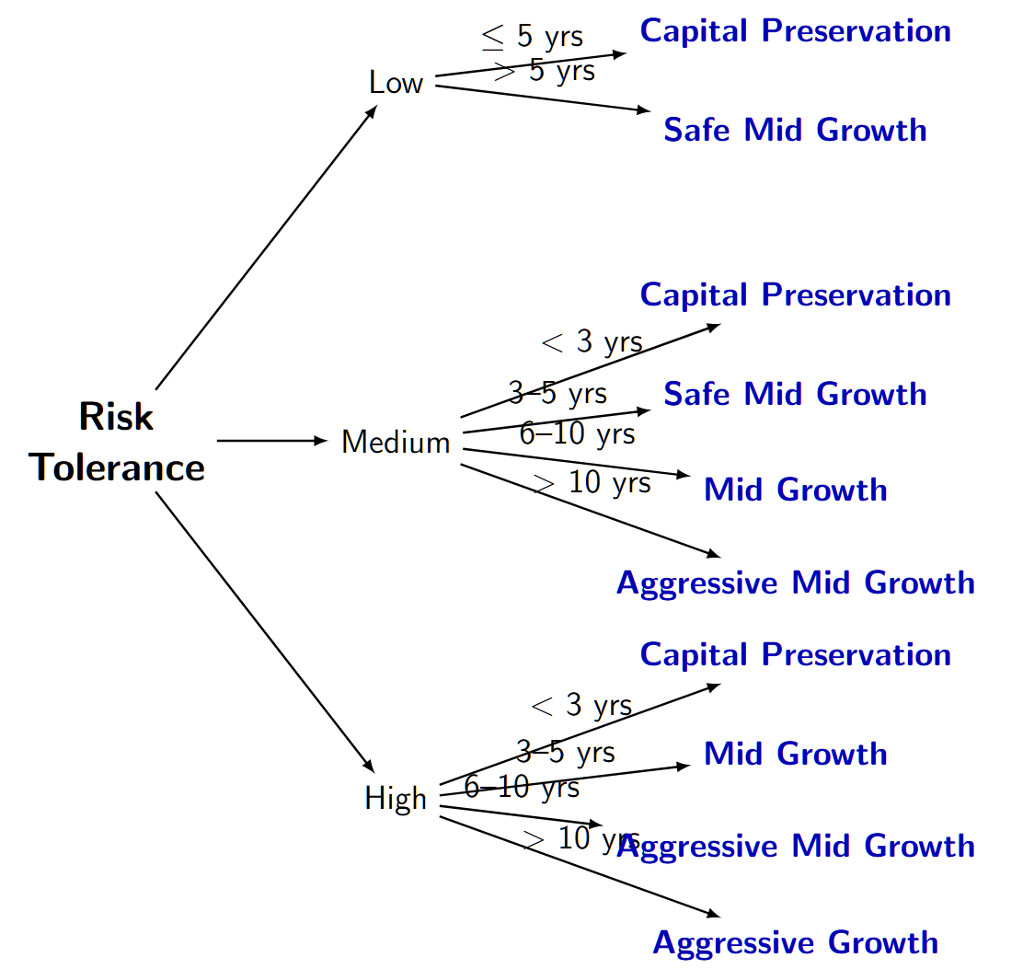
Rulebase (R) - Visual representation

Slide 12
Rulebase (R) - Rules 8 to 12
check-min-capital Warns users with under $1,000 that funds are insufficient to invest, advising HISA or GIC accounts instead.
emergency-fund-check Advises users with under $6,000 to create an emergency fund before committing to investing.
high-net-worth-hedge Recommends a gold to hedge against inflation when portfolios are over 1 million dollars.
approaching-withdrawal-shift Advises investors 3–10 years away from withdrawal to shift stocks and ETFs allocations to bonds or GICs.
inflation-risk-warning Alerts conservative investors that a long-term investment into low-return assets may lose real value to inflation.

Slide 13
Rulebase (R) - Rules 13 to 26
investment-horizon (4 rules) Converts the value of time horizon to qualitative explanations (Short, Medium, Long, Very Long) for the user.
explain-asset-classes (10 rules) Ten rules that provide information (risk level, return, literature explanation) for each asset class (refer to the 10 facts table in the earlier slide). The rule only appears if the asset is listed in the final recommendation.

Slide 14
Rulebase (R) - Rule 27
print-recommendation Formats and prints the final generated strategy name and detailed allocation message to the console.

Slide 15
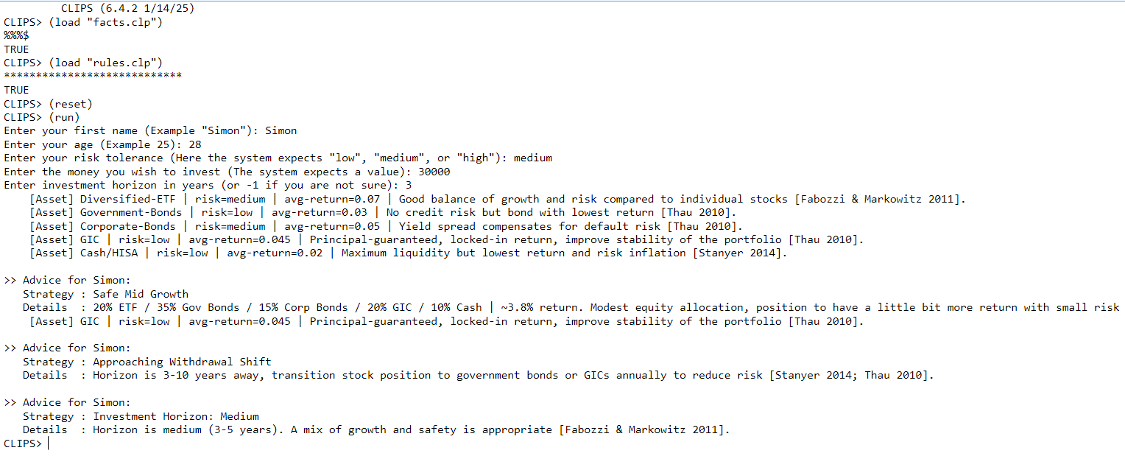
Combination K (F & R) - Requirement
The expert system (K) helps the user (U) towards planning a portfolio allocation (G)
The expert system has 27 rules and 10 facts

Slide 16
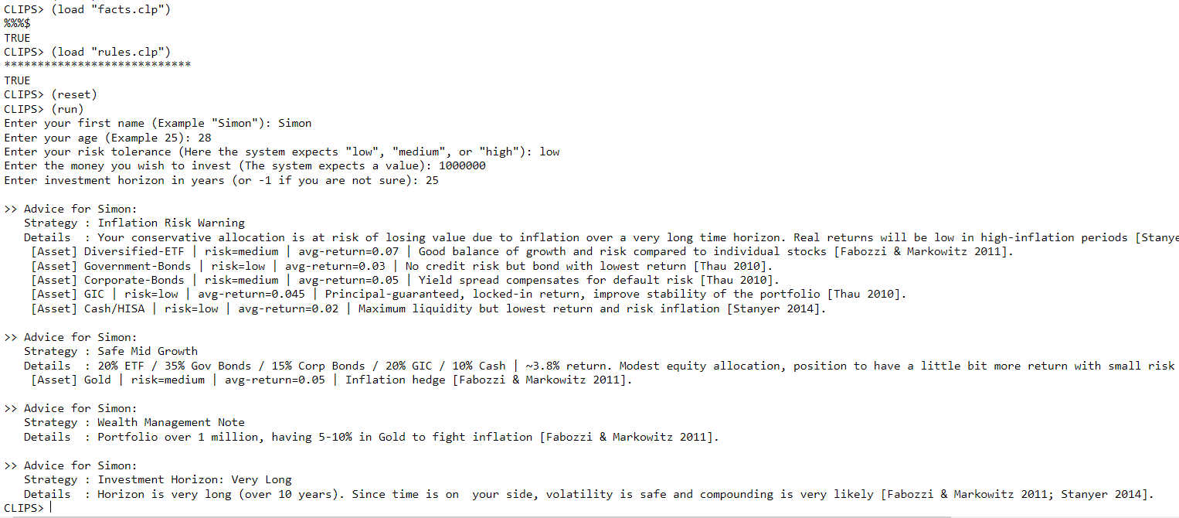
Combination K (F & R) - Design
The expert system uses proper naming scheme
I tried to balance granularity in my expert system (no rules too big nor too small)

Slide 17
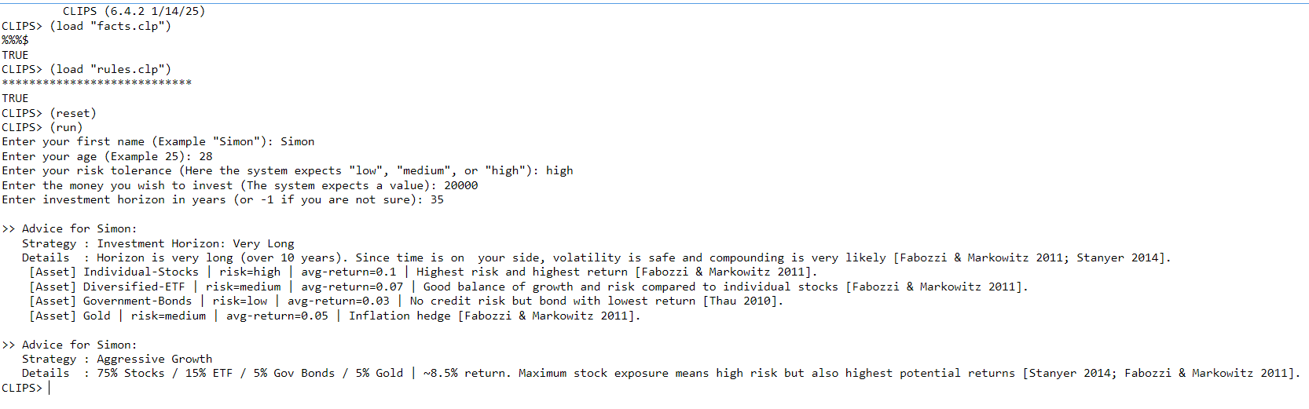
Combination K (F & R) - Implementation
Files are separated between rules and facts

Slide 18
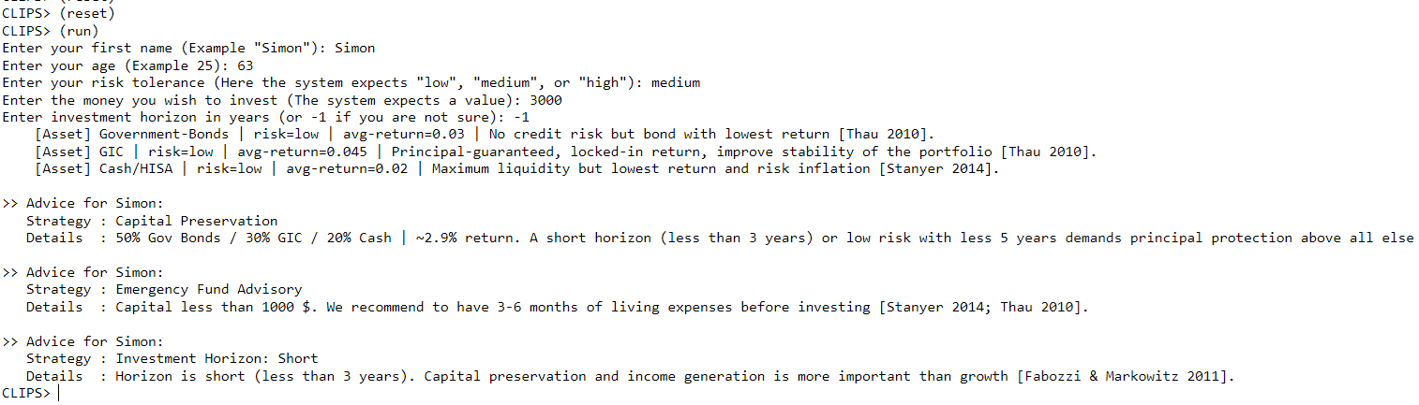
Combination K (F & R) - Validation
The 10 possible outcomes have been tested (combination of time horizon & risk acceptance)
Edge cases (low funds, close to retirement, large portfolio) have custom advices
Since I'm doing Option A, I didn't have symmetric or asymmetric review, but i reviewed my work before submission

Slide 19
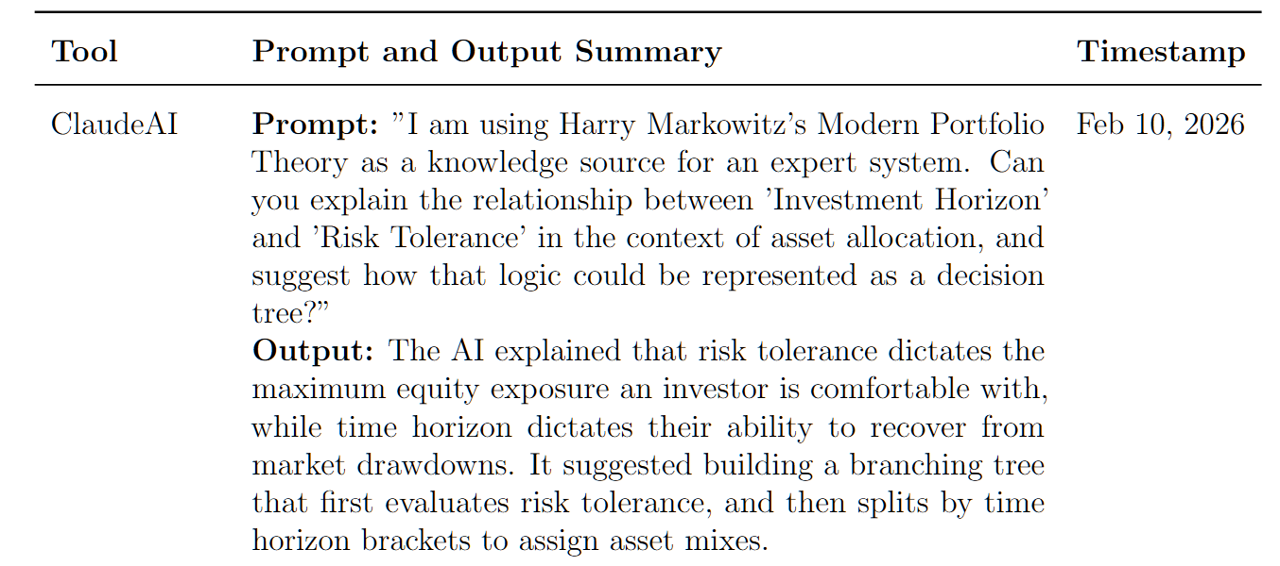
Generative AI Tool Disclosure
To make sure my assignment is fairly transparent, here is my generative AI disclosure for the prompts used in the making of this assignment and report.

Slide 20
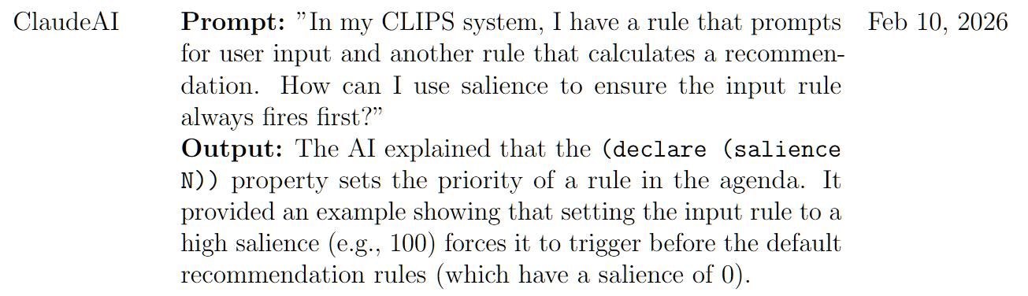
Generative AI Tool Disclosure
To make sure my assignment is fairly transparent, here is my generative AI disclosure for the prompts used in the making of this assignment and report.

Slide 21
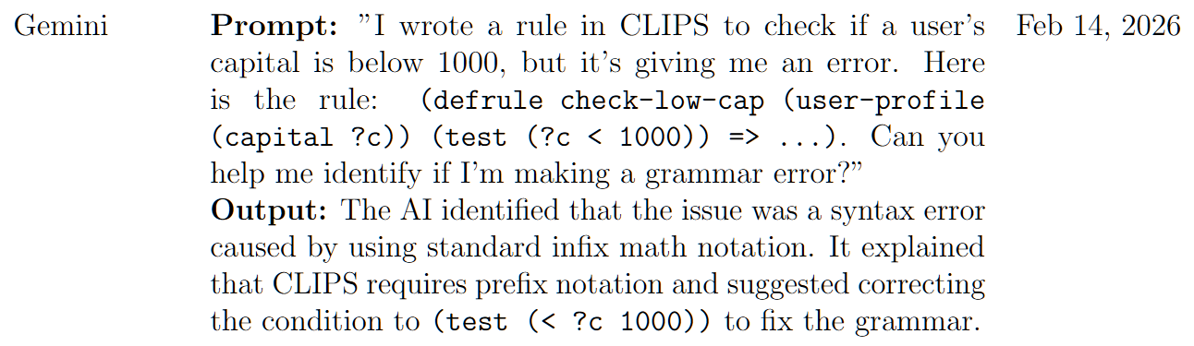
Generative AI Tool Disclosure
To make sure my assignment is fairly transparent, here is my generative AI disclosure for the prompts used in the making of this assignment and report.

Slide 22
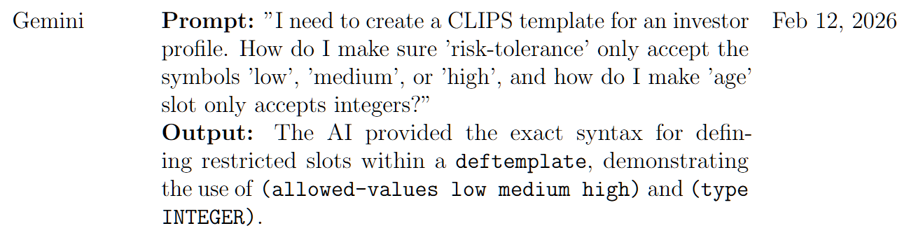
Generative AI Tool Disclosure
To make sure my assignment is fairly transparent, here is my generative AI disclosure for the prompts used in the making of this assignment and report.

Slide 23
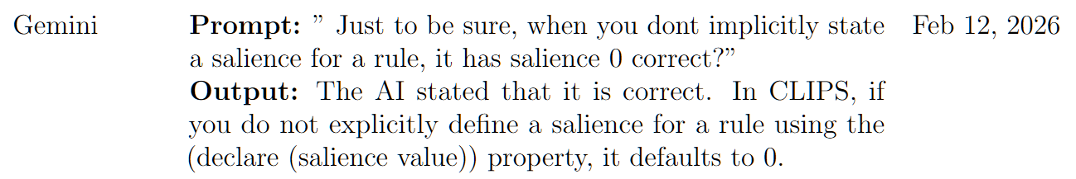
Generative AI Tool Disclosure
To make sure my assignment is fairly transparent, here is my generative AI disclosure for the prompts used in the making of this assignment and report.

Slide 24
References
[1] Fabozzi, F. J. and Markowitz, H. M. (Eds.). The Theory and Practice of Investment Management: Asset Allocation, Valuation, Portfolio Construction, and Strategies, 2nd ed. John Wiley & Sons, 2011.
[2] Stanyer, P. The Economist Guide to Investment Strategy: How to Understand Markets, Risk, Rewards and Behaviour, 3rd ed. Public Affairs, 2014.
[3] Thau, A. The Bond Book: Everything Investors Need to Know About Treasuries, Municipals, GNMAs, Corporates, Zeros, Bond Funds, Money Market Funds, and More, 3rd ed. McGraw-Hill, 2010.
[4] Markowitz, H. M. Portfolio Selection. The Journal of Finance, 7(1):77–91, 1952.

